Slide 1
MÔ PHỎNG QUÂN SỰ
Bài 5: Mô phỏng hành vi tập thể
Bộ môn KHMT – Khoa CNTT. Contact: tinnt@lqdtu.edu.vn

Slide 2
MÔ PHỎNG QUÂN SỰ
Nội dung
I. Mô phỏng hành vi alignment
II. Mô phỏng hành vi Cohesion
III. Mô phỏng hành vi Separation
IV. Mô phỏng hành vi Flocking
V. Mô phỏng hành vi Leader Following
Bộ môn CNPM – Khoa CNTT. Contact: khanh29bk@gmail.com

Slide 3
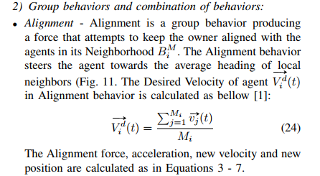
MÔ PHỎNG QUÂN SỰ
I. Hành vi alignment

Slide 4
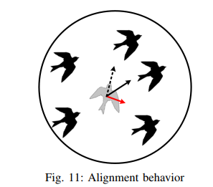
MÔ PHỎNG QUÂN SỰ
I. Hành vi alignment

Slide 5
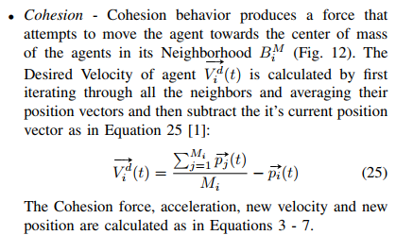
MÔ PHỎNG QUÂN SỰ
II. Hành vi Cohision

Slide 6
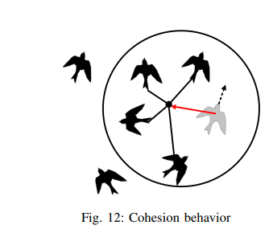
MÔ PHỎNG QUÂN SỰ
II. Hành vi Cohision

Slide 7
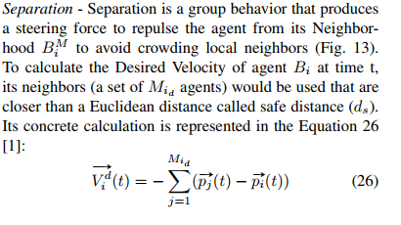
MÔ PHỎNG QUÂN SỰ
III. Hành vi Separation

Slide 8
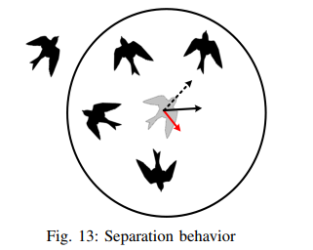
MÔ PHỎNG QUÂN SỰ
III. Hành vi Separation

Slide 9
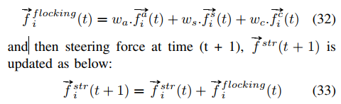
MÔ PHỎNG QUÂN SỰ
IV. Hành vi Flocking
Flocking - Flocking behavior (Emergent behavior) is a combination of three behaviors Alignment, Seperation and Cohesion. The velocity of agent is modified by applying three forces with different weights, denoted by scalers w_{a}, w_{s}, w_{c} respectively. In this case the Flocking force is calculated as below:

Slide 10
MÔ PHỎNG QUÂN SỰ
IV. Hành vi Flocking
We can combine the different behaviors metioned above, applies their weights, and truncates the result before returning to make more complex behaviors. It can work fine, but the trade-off is that it comes with a few problems:
• Since every behavior is calculated every time step, it can be a costly method to process.
• Behavior weights can be difficult to tweak.
• Some forces may be conflicted.

Slide 11
MÔ PHỎNG QUÂN SỰ
V. Hành vi Leader Following
Leader Following - The Leader Following behavior is a composition of some behaviors, all arranged to make a group of agents following a specific agent, called the leader. In the Leader Following behavior, the objective of each agent is to stay close enough to the leader, but slightly behind it. The agent should also move faster towards the leader when they are distant, but should slow down when the distance is small. To achieve this goal, We consider the Leader Following behavior as a combination of Arrival, Collision Avoidance, Evade and Separation behaviors. The Arrival behavior allows agents to move towards the leader and gradually slow down, eventually stopping the movement. The Collision Avoidance allows the leader to detect and avoid collision with agents-followers in its route. The Evade behavior allows a agent to quickly move away, if it is in the leader’s way. The Separation behavior allows to avoid crowding when several agents are behind the leader.

Slide 12

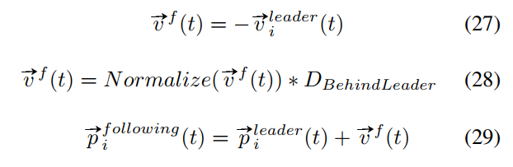
MÔ PHỎNG QUÂN SỰ
V. Hành vi Leader Following
The first task in Leader Following is finding the right point to follow and the second task is following and arriving to this point. When agents are very close to each other while following the leader, the result might seem unnatural. Since all agents will be influenced by similar forces, the agents tend to move similarly and they need to apply the Separation behavior to fix it.
Since the agents should try to stay slightly behind the leader with distance D_{BehindLeader} during the following process, they need to find the point to follow. The greater D_{BehindLeader}, the more distant the agents will remain from the leader. This point can be easily found based on the leader’s velocity, since it also represents the agent’s direction. We denote leader’s parameters by adding a superscript ”leader”. The following point of agent Bi at time t, is calculated as in the Equation below and the calculation is illustrated in Fig. 14:

Slide 13
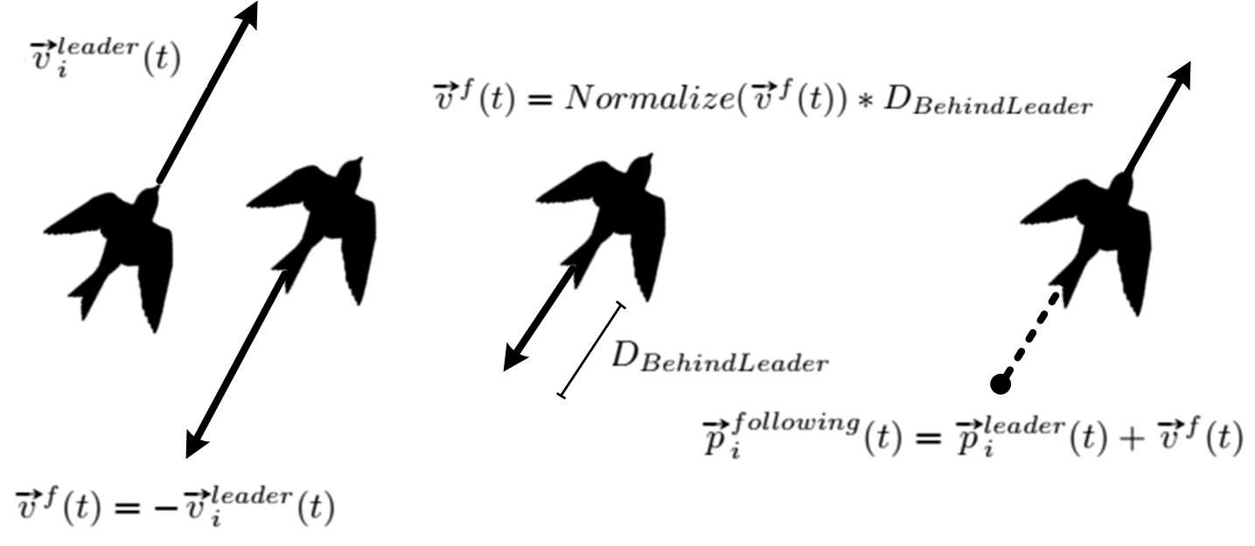
MÔ PHỎNG QUÂN SỰ
V. Hành vi Leader Following
Fig. 14: Finding Following Point
The next step is to make a agent follow the Following Point . It can be easily performed by using Arrival behavior. When the agents are very close to each other while following the leader, the Separation behavior described above can be used to prevent a group of agents from crowding, so they keep a certain distance from each other. If the leader suddenly changes the current direction, there’s a chance that the characters will end up getting in the way of the leader. If any agent gets in the way of the leader, it needs immediately to move away from the leader’s route

Slide 14
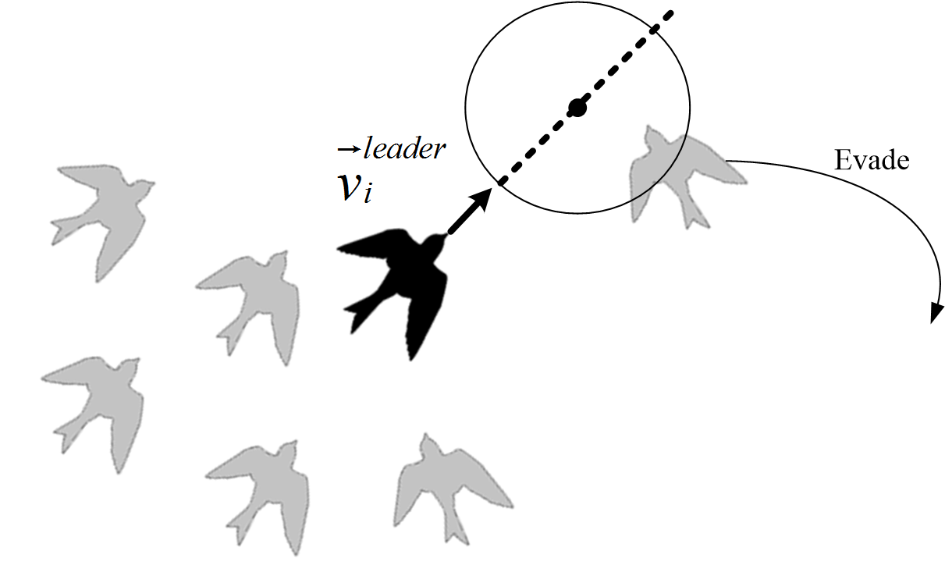

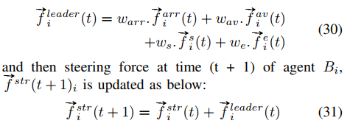
MÔ PHỎNG QUÂN SỰ
V. Hành vi Leader Following
This can be achieved using the Collision Avoidance behavior and Evade behavior (Fig. 15).
The leader will consider a agent on its way as an obstacle and try to avoid, and that agent will try to evade from the leader. The Arrival, Collision avoidance, Separation and Evade behaviors produce the corresponding forces , that can be aggregated together with different weights warr, wav, ws, we to make a steering force of Leader behavior .
Fig. 15: Leader Following behavior

